Slide 1
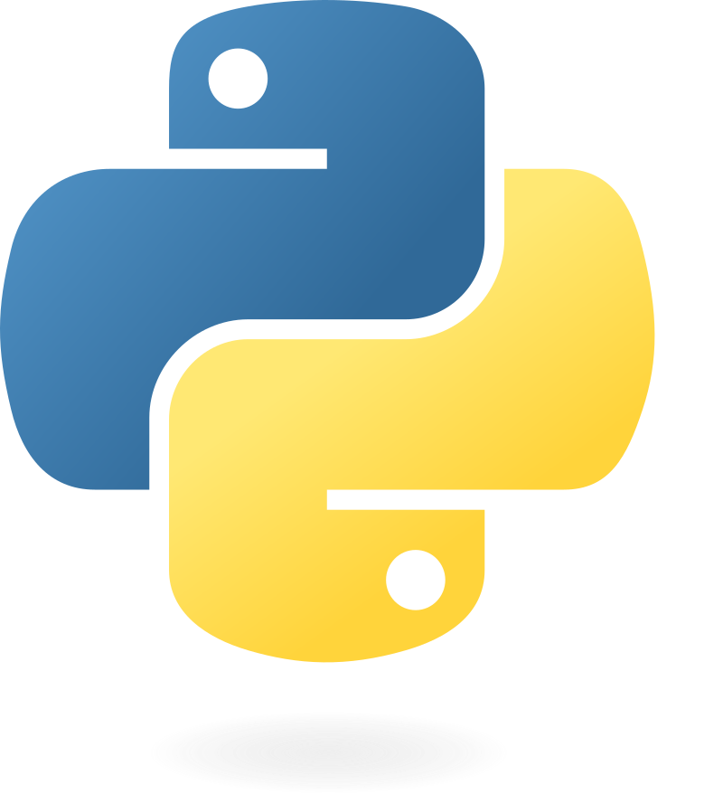
Personal Task Manager with Insights
Personal Task Manager with Insights : is a Python-based application designed to help users efficiently manage their tasks and track productivity. It allows users to add, update, and categorize tasks, set due dates, and generate reports to analyze their performance over time. With features like task search, sorting, and optional email reminders, the project ensures a user-friendly and organized approach to staying productive. Ideal for students, professionals, and busy individuals, it combines simplicity with practical functionality, making it a valuable tool for everyday task management.

Slide 2

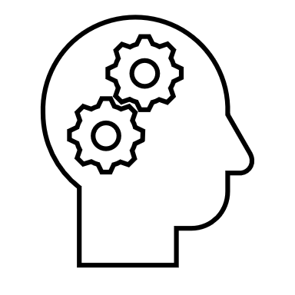

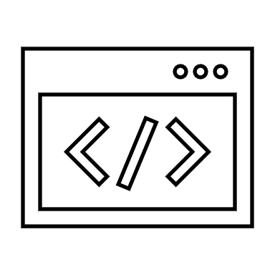

Purpose
To provide an easy-to-use tool for managing tasks and gaining insights into productivity patterns, helping users make better use of their time.
Problem Addressed
Many people struggle to stay organized and often lose track of tasks, leading to missed deadlines and reduced productivity. This project provides a simple yet powerful solution for organizing tasks and staying productive.
Key Functions
User Authentication
How to Use
Login/Register
Why my project?
Add Task
View Tasks
Update Task
Delete Task
Search/Sort Tasks
Generate Productivity Reports
Data Persistence
Optional Email Reminders
Visualization (Optional)
Add Tasks
View Tasks
Complete Tasks
Generate Report
Search/Sort
Export/ Visualize Data (Optional)
Unique Features
Innovation
Efficiency
User-Friendliness

Slide 3
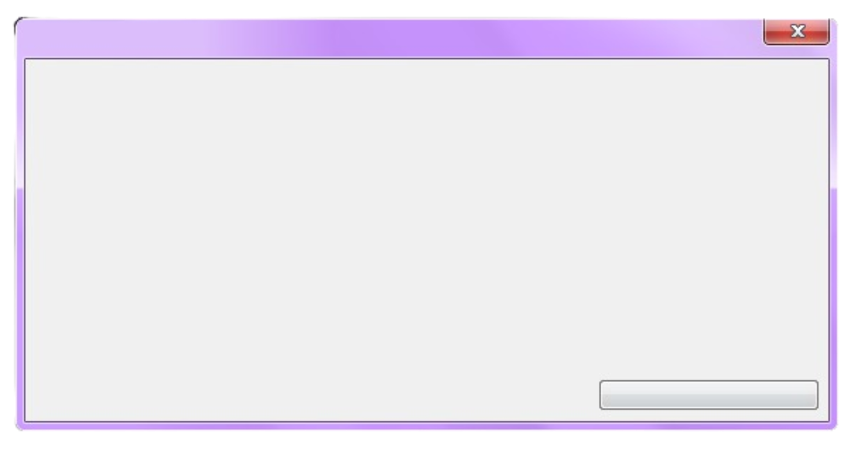
Introduction to the Project
"The best code is simple, elegant, and does exactly what it needs to do—nothing more, nothing less."
"The beauty of programming lies in solving impossible problems with just a keyboard and your mind."
Overview
print(“Hello, World!”)
The Personal Task Manager is a Python-based application designed to help users manage their daily tasks efficiently while providing insights into their productivity. It combines task organization with reporting features to improve time management and track progress.
Cmt = input(“Enter Your Feedback : ”)
Problem_Addressed
The project addresses the problem of task disorganization and poor productivity management. Many individuals struggle to keep track of tasks, leading to missed deadlines and reduced efficiency. This application provides a centralized platform to organize tasks, set priorities, track deadlines, and gain productivity insights, helping users stay organized and improve time management.
continue
print(Overview)
print(Problem_Addressed)
continue

Slide 4
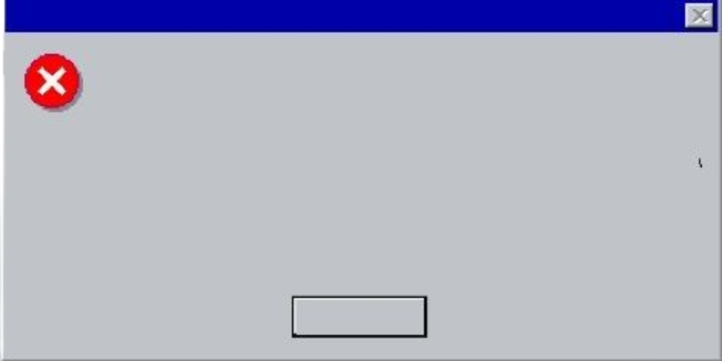
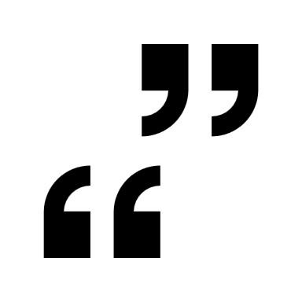


Goal / Purpose
"Every error you fix is a step closer to mastery."
"Don’t just write code; craft solutions that inspire."
Purpose
Goal
The purpose of this project is to create an efficient and user-friendly tool that allows individuals to manage tasks, track deadlines, and organize their daily activities. By offering features like categorization, prioritization, and productivity insights, it aims to help users stay organized, meet deadlines, and improve their overall time management and efficiency.
The goal of the project is to help users efficiently manage their tasks and improve productivity. It provides a simple platform to organize, prioritize, and track tasks while offering insights to analyze and optimize time management.
def greeting(name): print("Hello, " + name)
continue
continue
Main_Objectives
line = 8
i = 1
while i <= line:
j = 1
while j <= i:
print(j, end=" ")
j += 1
print()
i += 1
import mymodule mymodule.greeting(“Viewer")
Allow users to organize tasks by category, due date, and priority.
Provide weekly and monthly productivity reports with actionable insights.
Ensure a user-friendly experience for managing tasks effectively.
continue

Slide 5

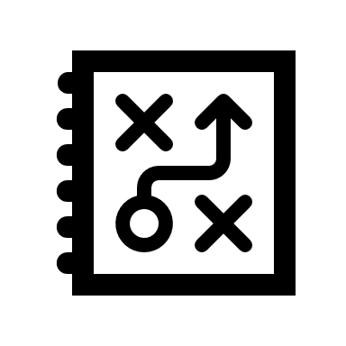
Affected People
"Programming is the art of turning coffee into logic."
import random
while True:
rand_num = random.randint(1, 100)
print(rand_num)
if rand_num == 69:
break
Target Users
Students: To manage study schedules and assignments.
Professionals: To organize work-related tasks and deadlines.
Busy Individuals: To keep track of personal errands and goals.
How It Helps
continue
Students can track assignments and exams, improving academic performance.
Professionals can prioritize and complete tasks on time, reducing stress.
Individuals can organize daily activities and stay on top of responsibilities.
import os
files = os.listdir(".")
with open("file_list.txt", "w") as file:
for f in files:
file.write(f + "\n")
continue

Slide 6
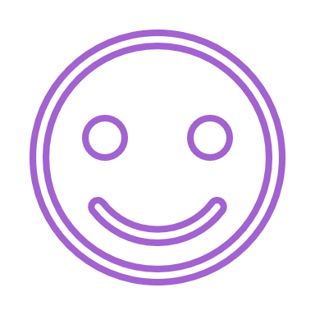
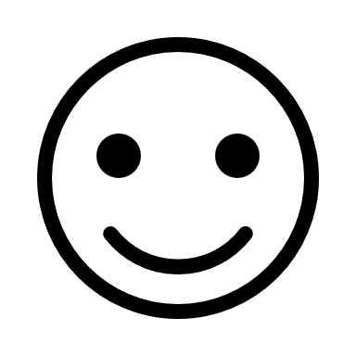
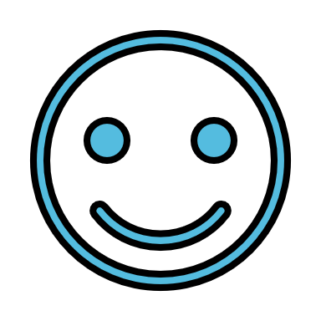

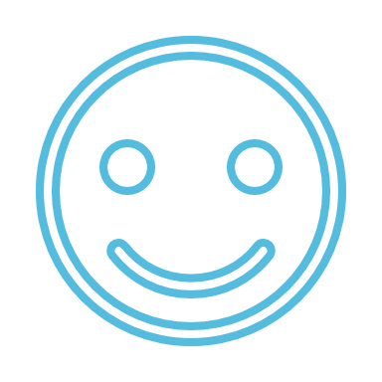
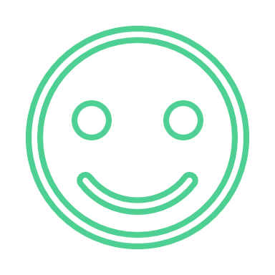

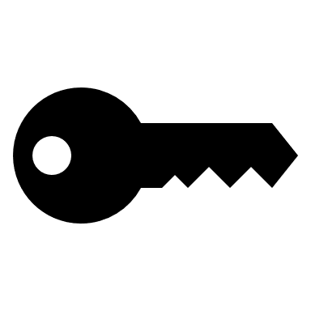

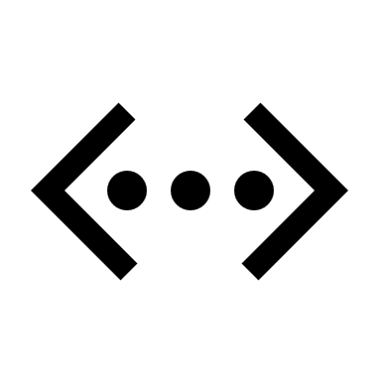
Functionalities
Key Features
User Authentication: Allows users to register, log in, and securely access their task data.
Add Task: Create new tasks with details like name, category, priority, and due date.
View Tasks: Display all tasks, categorized by status (completed/pending) and other filters.
Update Task: Edit task details or mark tasks as complete/incomplete.
Delete Task: Remove tasks no longer needed.
Search/Sort Tasks: Search tasks by keywords and sort them by due date, category, or priority.
Generate Productivity Reports: Analyze completed vs. pending tasks and view category-wise breakdowns.
Data Persistence: Save tasks in a JSON file or database for reuse after closing the app.
Optional Email Reminders: Send notifications for upcoming tasks using the smtplib module.
Visualization (Optional): Display productivity stats as bar charts or pie charts using matplotlib.
weight = get_positive_float("Enter your weight in kilograms: ") height_in_feet = get_positive_float("Enter your height in feet: ") height_in_meters = height_in_feet * 0.3048 # (1 foot = 0.3048 meters) bmi = weight / (height_in_meters ** 2) bmi = round(bmi, 2) if bmi < 18.5: category = "Underweight" elif 18.5 <= bmi < 24.9: category = "Normal weight" elif 25 <= bmi < 29.9: category = "Overweight" else: category = "Obesity" print(f"\nYour BMI is: {bmi}") print(f"You are categorized as: {category}") calculate_bmi()
def calculate_bmi():
def get_positive_float(cmd):
while True:
try:
value = float(input(cmd))
if value > 0:
return value
else:
print("Please enter a positive number.")
except:
print("Invalid input. Please enter a valid number.")
"Code is like humor—if you have to explain it, it’s not good enough."
continue

Slide 7

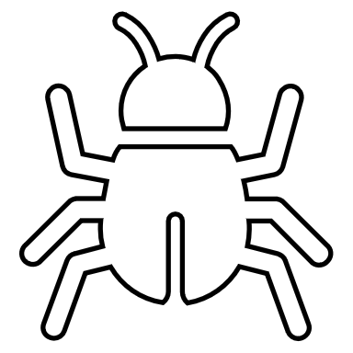
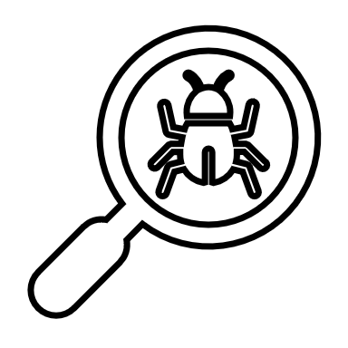
How to Use
Visual Studio Code (VS Code) is a free, open-source code editor developed by Microsoft. It supports a wide range of programming languages, including Python, JavaScript, HTML, and more. Known for its lightweight design and powerful features, VS Code offers a customizable interface, integrated debugging tools, extensions, Git integration, and an intelligent code editor with features like syntax highlighting and autocompletion. It's widely used by developers for its efficiency, flexibility, and extensive library of extensions to enhance productivity.
Step-by-Step Guide
Login/Register: Start by creating an account or logging in.
Add Tasks: Enter the task name, category, due date, and priority.
View Tasks: Check the list of tasks with their details.
Complete Tasks: Mark tasks as complete once done.
Generate Report: View weekly/monthly reports showing productivity stats.
Search/Sort: Use filters or search functionality to quickly find tasks.
Export/Visualize Data (Optional): Generate graphs or send reminders.
Python is a high-level, interpreted programming language created by Guido van Rossum in 1991. Known for its simplicity and readability, Python supports multiple programming paradigms, including procedural, object-oriented, and functional programming. It is widely used in web development, data analysis, artificial intelligence, machine learning, automation, and more. With its extensive standard library, large community, and vast ecosystem of third-party libraries, Python has become a versatile and beginner-friendly language suitable for both small projects and large-scale applications.
"Behind every successful program is a coder who never stopped debugging."
continue

Slide 8


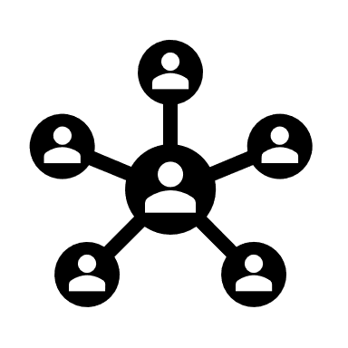

Why My Project is the Best
My project is the best because it combines simplicity, efficiency, and practicality to address the common problem of task management. Unlike other solutions, it not only helps users organize and prioritize their tasks but also provides productivity insights to analyze and improve performance. Its user-friendly interface, customizable features, and optional add-ons like email reminders and data visualization make it a unique and effective tool for staying organized and productive.
AN Productions – Turning Ideas into Reality
"Programming isn’t about what you know; it’s about what you can figure out."
Innovation
Unique Features
"A good programmer writes code that humans can understand, not just machines."
Combines task management and productivity insights into one tool.
Includes optional features like email reminders and visual reports for added convenience.
Simple, user-friendly interface suitable for all types of users.
Unlike other tools, it integrates insight generation and data visualization for personalized productivity tracking.
continue
continue
Efficiency
User Friendliness
Lightweight and fast, as it’s built with Python, focusing on essential features without unnecessary complexity.
The intuitive menu-driven interface ensures that even beginners can navigate and use the application effectively.
continue
continue

Slide 9
My Introduction
My name is Ahnaf Mahmud Towseem Ahan, and I am currently a student of Class 10 EV, Science Department at Willes Little Flower School and College. I have a strong interest in technology and programming, which has led me to pursue an ongoing Python Crash Course offered by the Songjog Foundation, taught by the highly skilled instructor Mushfiqur Ahmed Anik.
The idea for my project came from my father, whose guidance inspired me to work on solving real-world problems through programming. To execute the project effectively and ensure its success, I conducted a brief but thorough review of internet resources. My goal is to make my project the best by combining innovation, functionality, and user-friendly features.
“We are programmers, our first love is error.”
"Code is not just a set of instructions; it's a language where creativity meets logic to build the future."
I actively share my work on GitHub at ANAHAN07. You can also explore my instructor’s GitHub at Musfique-Ahmed for additional learning resources.
I am deeply passionate about applying my knowledge of Python to meaningful projects and continuously look for opportunities to turn my ideas into reality. For any correspondence,
you can reach me at ahnaftowseem2021@gmail.com or ahanclientservice@gmail.com.

